Slide 1
Real-Time Telemedicine in Ophthalmology
Sam McCauley, Bryce Kushner, Shelby Stocker, and Cole Terrell

Slide 2
Outline
Project Scope
High-Level Discussion of Architecture and Implementation
Maintenance
Description of Hardware and Software Requirements
Use Case Overview and Demo
Testing
Acceptance Testing
Unit Testing
Metrics
Lessons Learned
Conclusion
Q&A

Slide 3
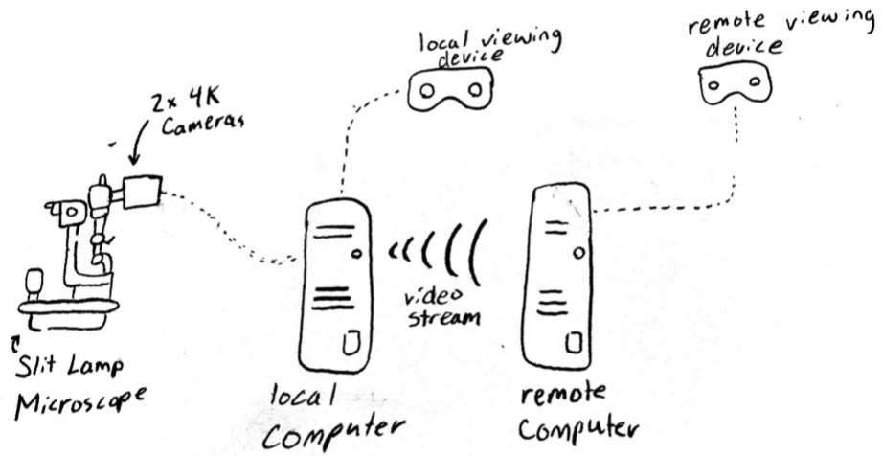
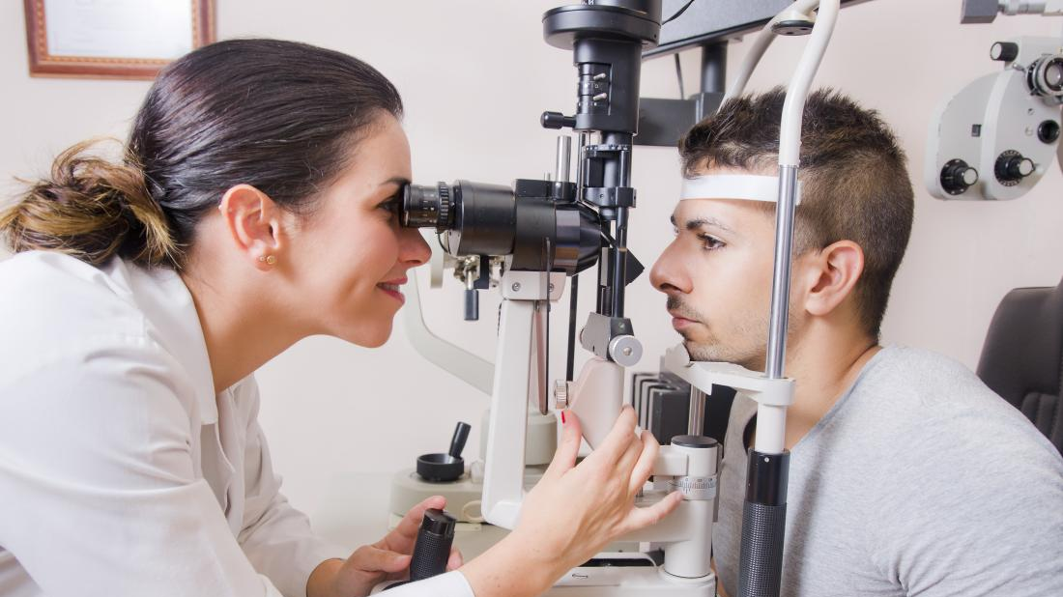
Project Scope
Primary Objective: Digitize slit-lamp microscope viewing such that multiple users in different locations can see a patient’s eye simultaneously.

Slide 4
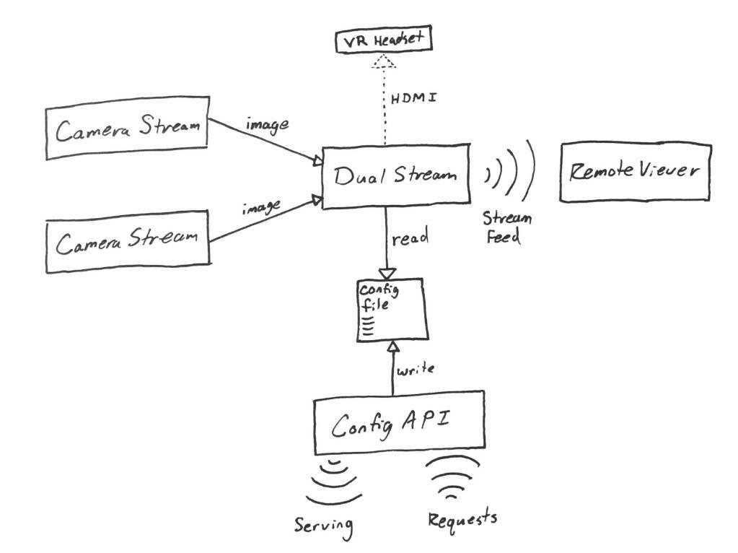
Architecture and Implementation

Slide 5
dual_camera.py (OpenCV)
Twitch/OBS
App.py
(Flask)

Slide 6
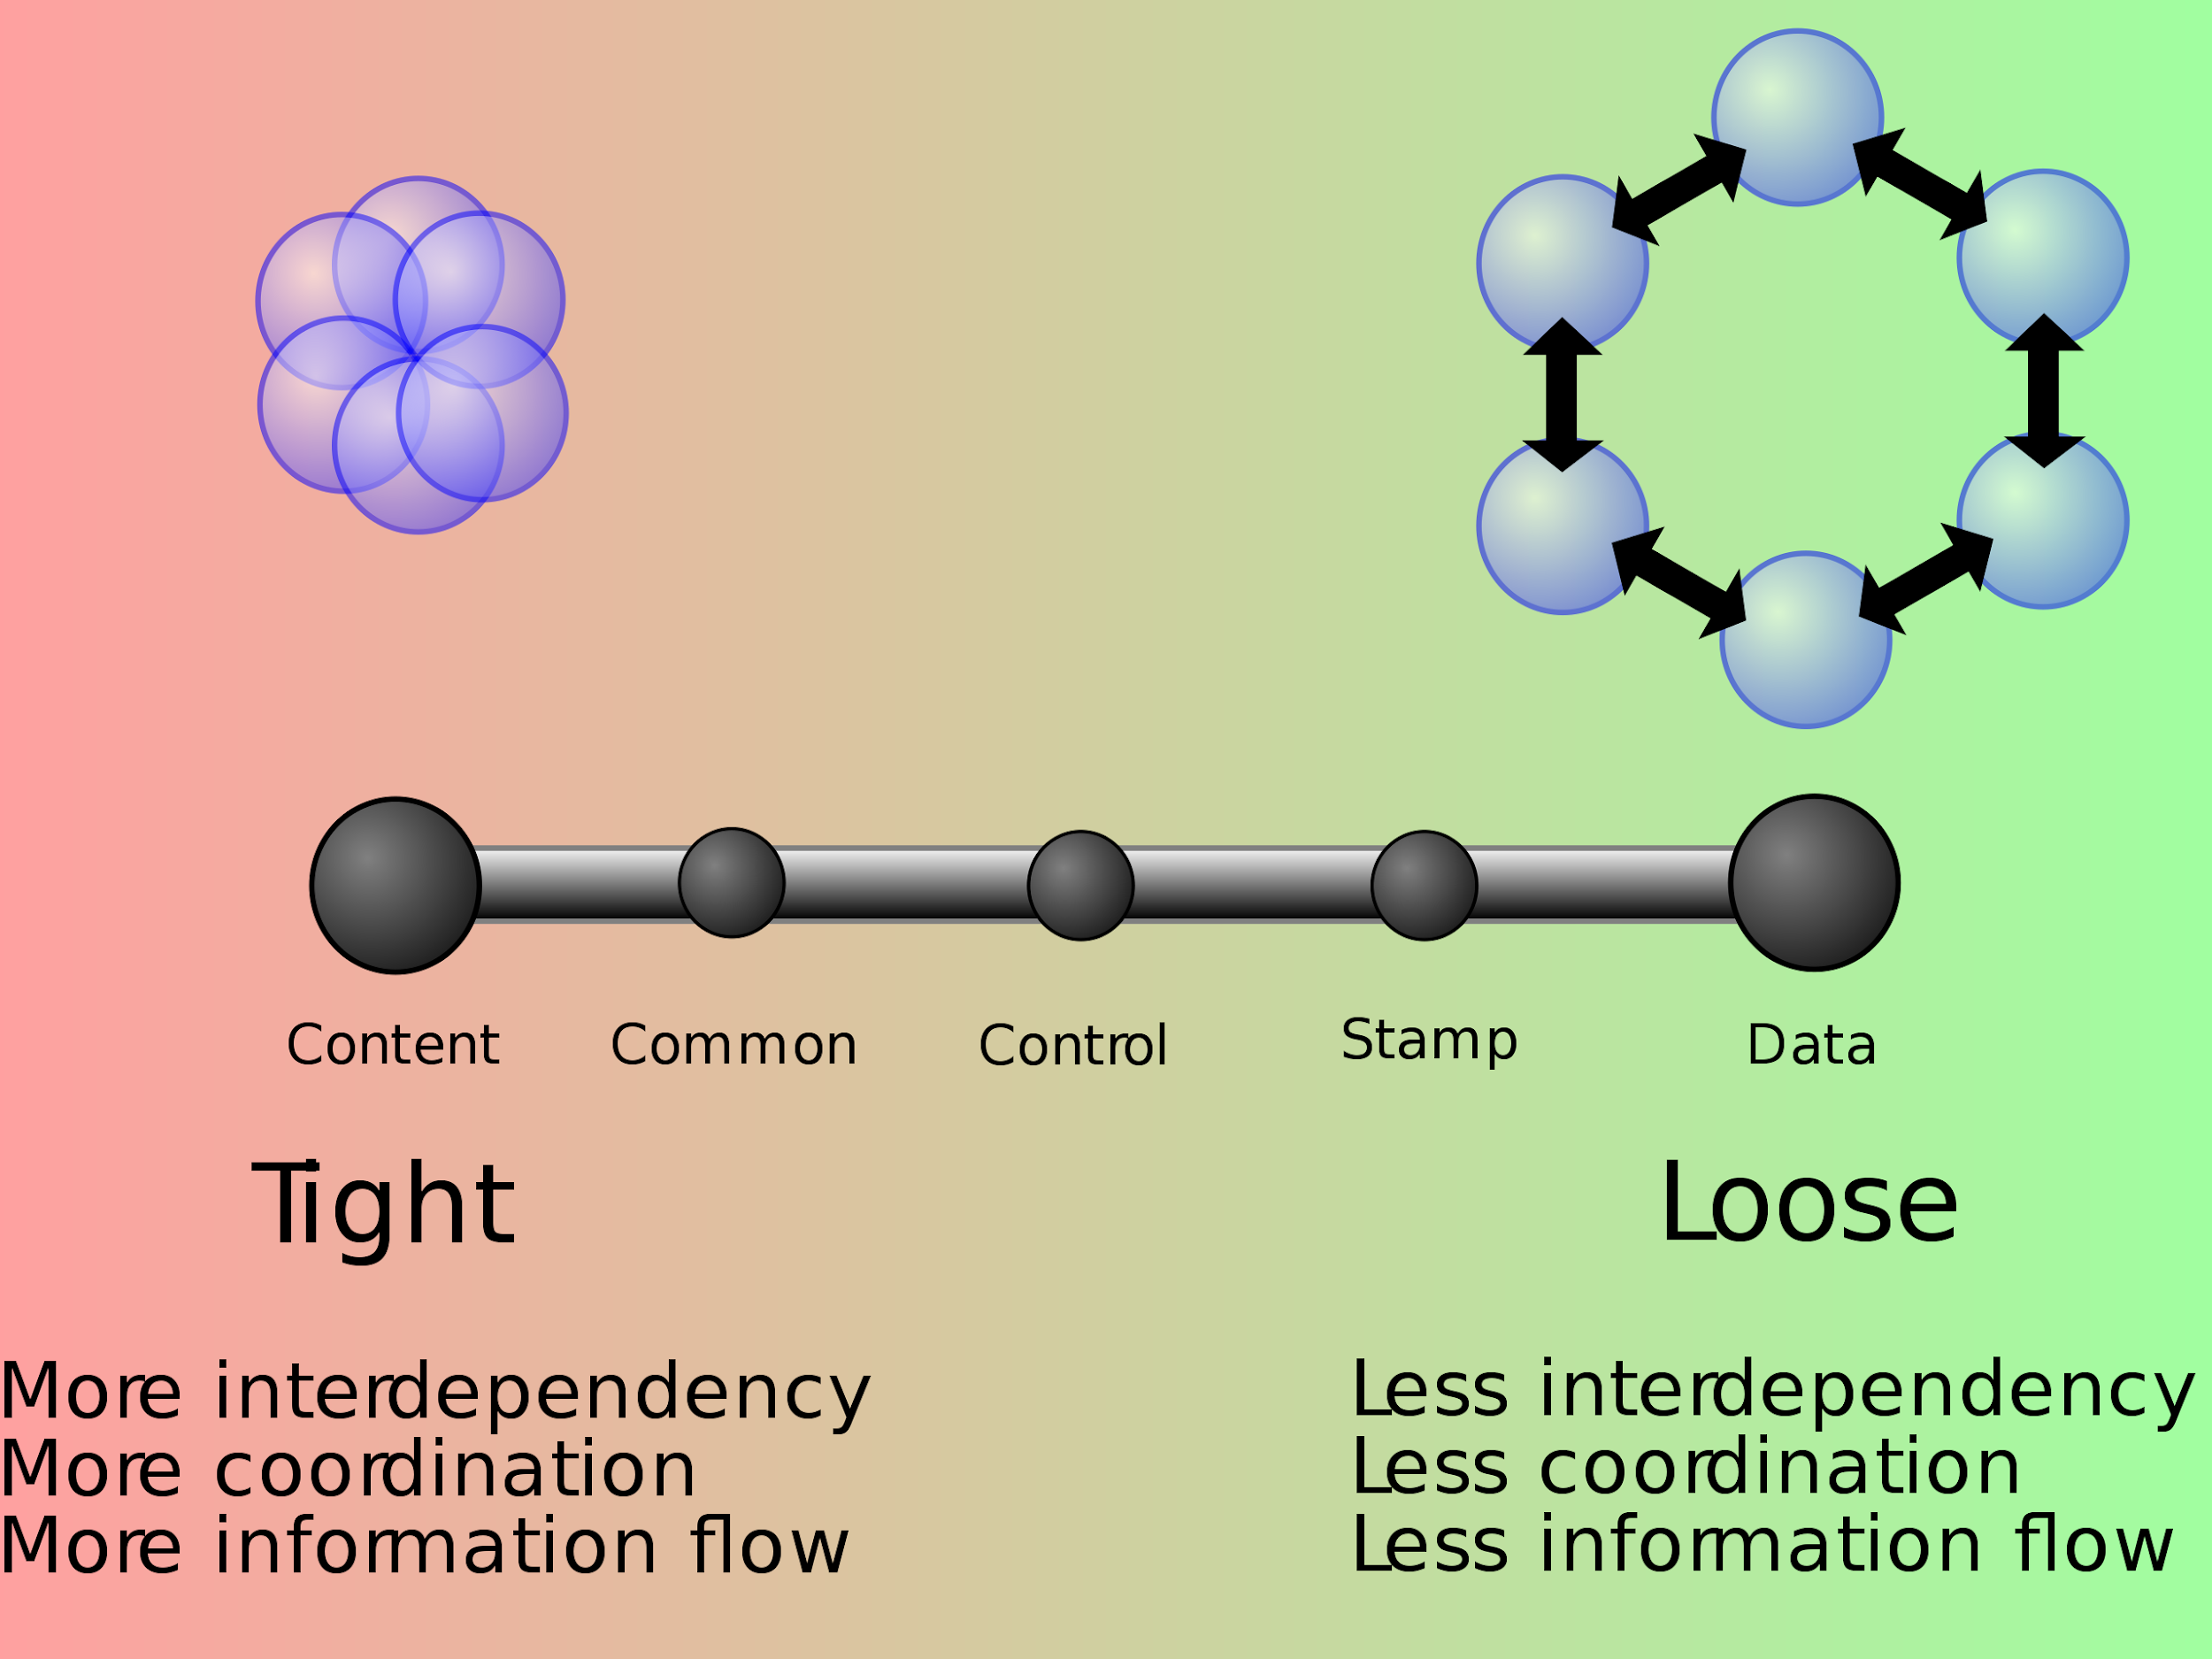
Maintenance
source: wikipedia -- coupling
Data coupling (LOWEST level of coupling)
Modular nature of our product allows for integration of new features with little to no impact on functionality of unrelated modules

Slide 7
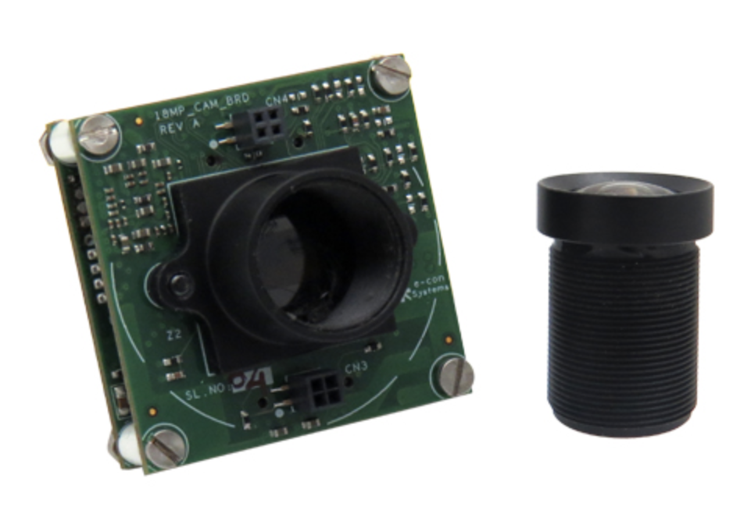
Hardware Requirements
2x E-con Systems See3CAM_CU130 4K USB cameras

Slide 8
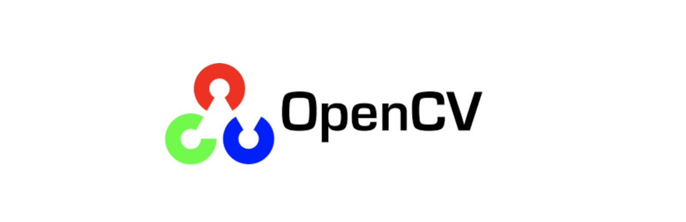



Software Requirements
OpenCV v3.4.1
&
Custom videoio module provided by E-con Systems
Python Web Microframework
Video Encoding and Live Streaming

Slide 9
Use Case Overview
Module 1 (Local Stream)
dual_camera.py
Camera sources (typically 0 and 2)
OpenCV imshow()
Module 2 (Settings UI)
app.py
Settings web page with sliders and buttons
config.json read by dual_camera.py to update settings
Module 3 (Remote Stream)
OBS Display Capture mirrors what is on the desktop
Streamed publicly via Twitch

Slide 10
Demo
https://www.twitch.tv/videos/516722884?t=0h0m23s
https://www.twitch.tv/videos/516722884?t=0h1m3s

Slide 11
Acceptance Testing
Test Case | Result
Video feed streamed locally | Pass
Video feed streamed remotely | Pass
Settings page is functional | Pass
Video stream can be recorded and downloaded | Pass

Slide 12
Unit Testing
11 unit tests, all performed manually
Case Number | Test Case | Pass Conditions | Fail Conditions | Results
5 | app.py func update_values() | Dictionary values of CONFIG_SETTINGS are updated based on the values from the html page | Dictionary values of CONFIG_SETTINGS are not updated based on the values from the html page | Pass
9 | app.py func send_values() | The dictionary CONFIG_SETTINGS is properly sent in json formatting via a GET http request | The dictionary CONFIG_SETTINGS is not properly sent in json formatting via a GET http request | Pass

Slide 13
Metrics
Story Points
3 points: local video stream from the two 4k cameras on the slit lamp to a viewing device or VR headset
5 points: remote video stream from the two 4k cameras to a remote viewer
3 points: settings page to adjust camera properties
2 points: ability to record and store the video stream

Slide 14
Metrics
User Stories
As an ophthalmologist, I want to be able to change visual settings of the image, so that I can adjust the way the image looks to better suit my needs.
As an ophthalmologist, I want to be able to view on a virtual reality headset a video feed of my patient’s eyes through a slit lamp, so that I have a digitized experience.
As a secondary ophthalmologist, I want to be able to view remotely a video feed of the primary ophthalmologist’s patient’s eyes through a slit lamp, so that I can assist the primary physician.
As an ophthalmologist, I want to be able to record the video stream of my patient’s eyes, so that I can look at it later.

Slide 15
Metrics
Product Effort
Total time spent: approximately 50 hours
Most difficult aspect: ensuring we had the proper software installed
Issues across various group members devices and implementations
Certain versions of openCV required when dealing with camera property controls

Slide 16
Lessons Learned
Open communication with clients is critical
Our client had valuable technical knowledge that was instrumental to our success.
Research the tools that already exist and do part of the job well
Don’t reinvent the wheel

Slide 17
Conclusion
Digitizing the slit-lamp viewing experience
Leveraged OpenCV, Flask, Twitch, and OBS to produce local and remote streams from 4K cameras
Three module structure allows for maintenance and additional features with minimal impact on other modules
Demo shows that our product is functional and scalable
Product passed all acceptance and unit tests

Slide 18

Questions?

Slide 19
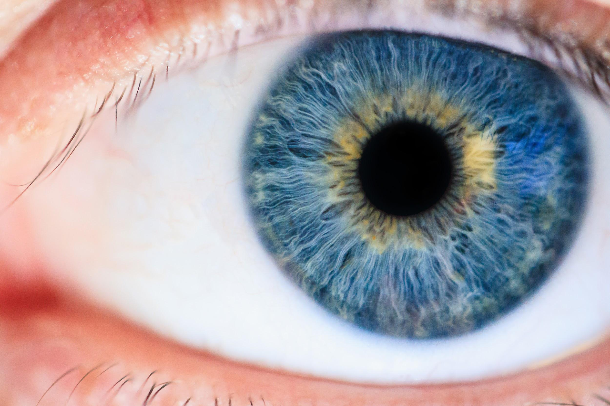
Real Time Telemedicine in Ophthalmology
Objective: Digitize slit-lamp microscope viewing such that multiple users in different locations can see a patient’s eye simultaneously.
;Bryce Kushner, Sam McCauley, Shelby Stocker, Cole Terrell

